Slide 2
Merkle Trees
Another useful data structure that we can build using hash pointer is a binary tree.
A binary tree with hash pointers is known as Merkle Tree, named after it’s inventor Ralph Merkle.

Slide 3
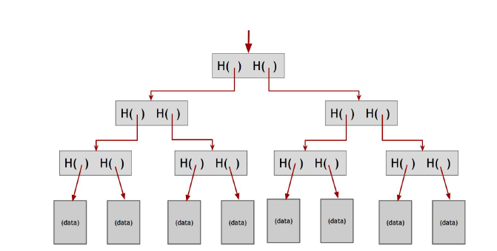
Merkle Trees

Slide 4
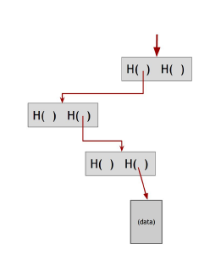
Proof of membership
Another nice feature of Merkle tree is that, unlike the blockchain that we built before, it allows a concise proof of membership.
If someone wants to prove that a certain data block is a member of the Merkle Tree, It is completely possible.
They need to basically show us the data block and the path from that data block to the root. Rest of the tree can be ignored, as the block on this path are enough to allow us to verify the hashes all the way up to the root of tree.

Slide 5
Proof of Non-membership
If these two items are consecutive in the tree, then this serves as a proof that the item in question is not included.
For it to be included, it would need to be between the two items shown, but there is no space between them as they are consecutive.
The way it is possible to prove membership, similarly Merkle tree also enable us to verify non-membership.
We can prove that a particular block is not in the merkle tree by showing a path to the item that’s just before where the item in question would be and showing the path to the item that is just after where it would be.

Slide 6
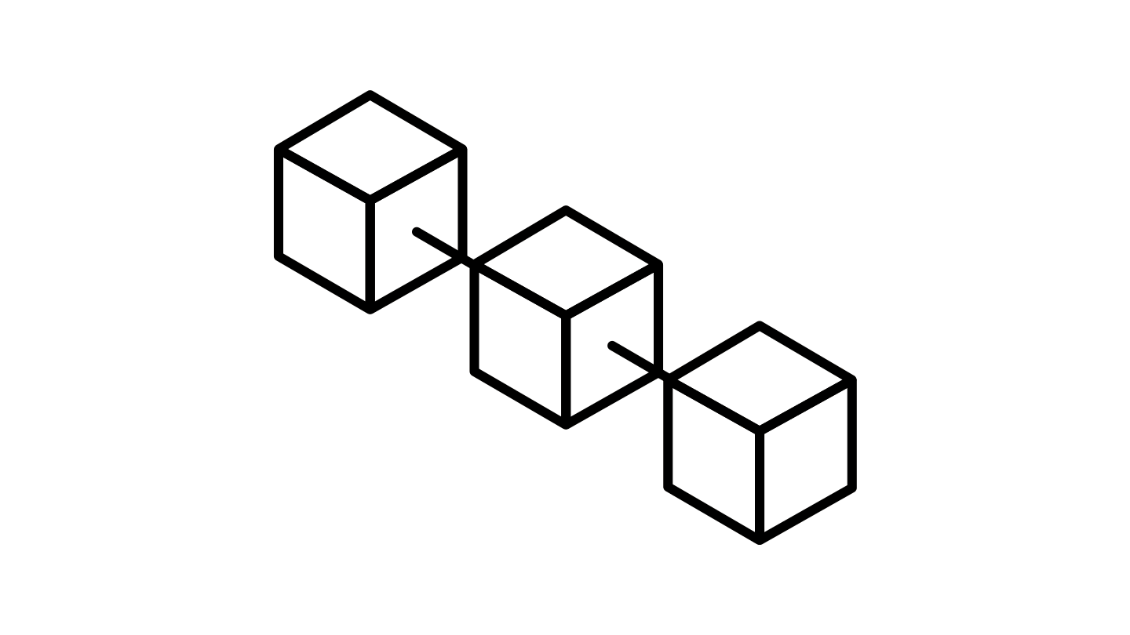
Advantages of blockchain
The blockchain technology allows for verification without having to be dependent on third-parties.
The data structure in a blockchain is append-only. So, the data cannot be altered or deleted.
It uses protected cryptography to secure the data ledgers. Also, the current ledger is dependent on its adjacent completed block to complete the cryptography process.
All the transactions and data are attached to the block after the process of maximum trust verification. There is a consensus of all the ledger participants on what is to be recorded in the block.
The transactions are recorded in chronological order. Thus, all the blocks in the blockchain are time stamped.

Slide 7
Advantages of blockchain
The ledger is distributed across every single node in the blockchain who are the participants. So, it is distributed.
The transactions stored in the blocks are contained in millions of computers participating in the chain. Hence it is decentralized. There is no possibility that the data if lost cannot be recovered.
The transactions that take place are transparent. The individuals who are provided authority can view the transaction.
The origin of any ledger can be tracked along the chain to its point of origin.
Since various consensus protocols are needed to validate the entry, it removes the risk of duplicate entry or fraud.
With the smart contracts, the businesses can pre-set conditions on the blockchain. The automatic transactions are triggered only when the conditions are met.

Slide 8
Benefits of blockchain for data security
Trust
Formation of trusted partnerships
Privacy
Assurance of individual privacy
Integrity
Maintenance of Data veracity
Resiliency
Prevention of data loss

Slide 9
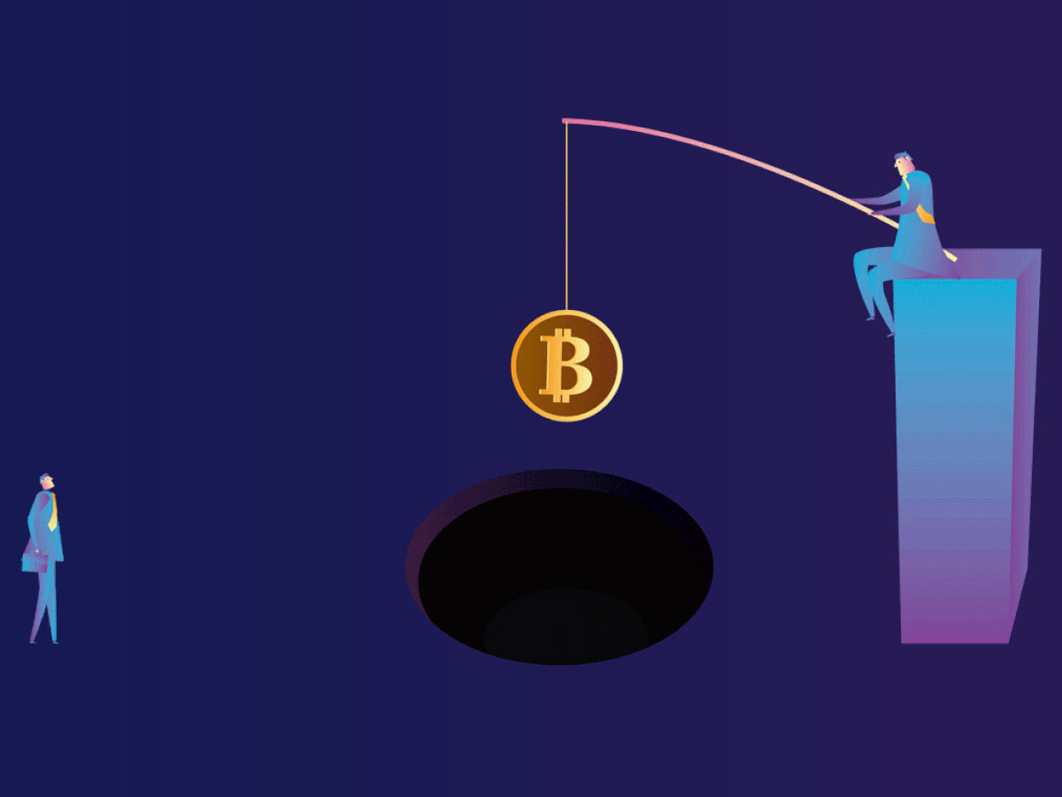
Trust
Blockchain provides a decentralized, transparent database that ensures trust between network participants.
The participants can be partners in a supply chain or businesses in a consortium, who use blockchain to record transactional data and other shared information.
Due to the blockchain’s democratization of control, it enables all participants to have equal access to the stored data and seeks consensus from all participants before approving any change.
This decentralized trust model can enable the formation of secure ecosystems that groups of companies can use for storing and sharing data.

Slide 10
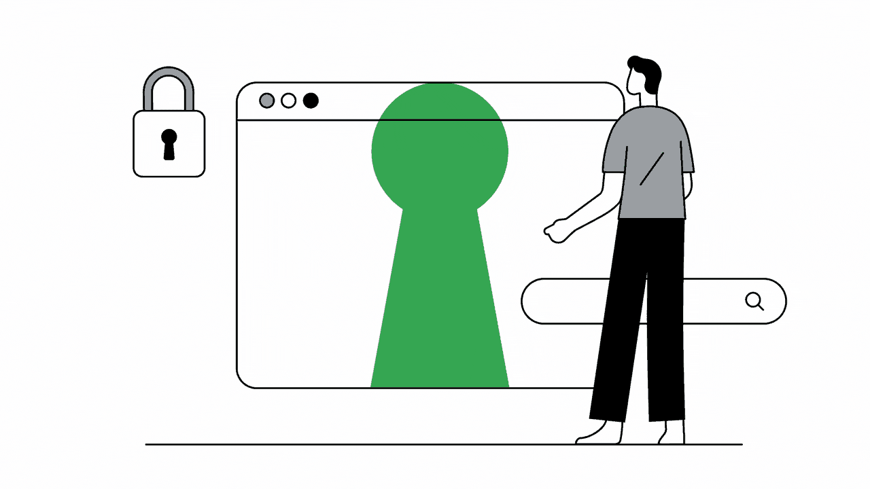
privacy
There has been a misconception among the public and the business community regarding the compatibility of blockchain with the recently passed General Data Protection Regulation (GDPR).
The perceived incompatibility is due to the competing nature of blockchain which is essentially immutable with GDPR, which requires organizations to erase private data upon the owner’s request.
Blockchain permanently stores older blocks of data to maintain an unalterable series of records and transactions.
This ensures that the provenance of every new block can be verified and traced back throughout the chain’s history.

Slide 11
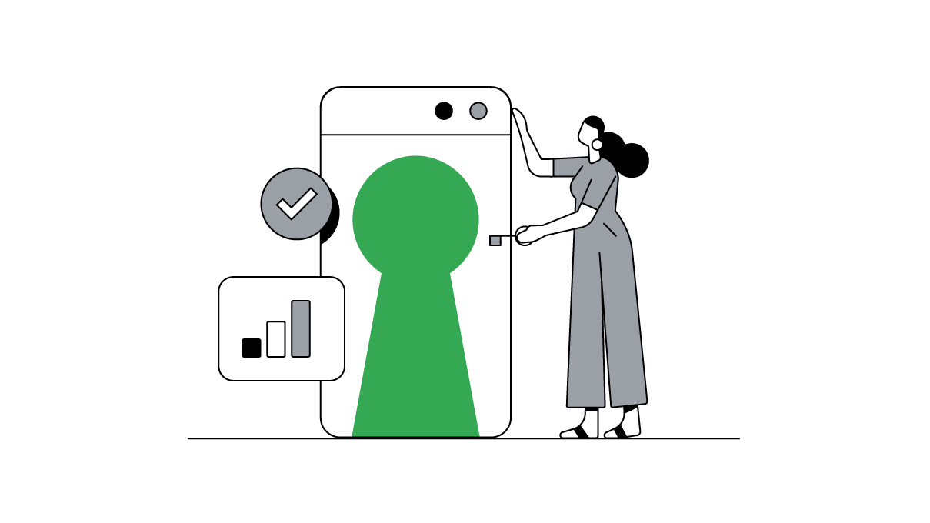
privacy
GDPR requires the erasure of personal data when requested by the individual, which, theoretically, blockchain does not allow.
However, designing a GDPR-compliant blockchain is possible and multiple methods are being devised to achieve that.
This can enable the use of blockchains to store anonymized data, such as customer records through hashing and tokenization.

Slide 12
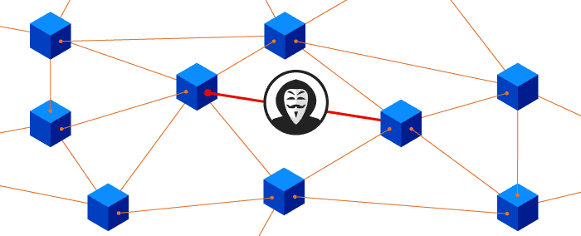
Integrity
Data integrity is a foundational property of data stored on the blockchain.
Accessing and modifying the data stored on the blockchain is nearly impossible without notifying and seeking consensus from the entire network.
Thus, blockchain can be used as the source of truth by participants and drive a secure ecosystem that can function in a trustless manner, i.e., without requiring any trust or even familiarity with the other party.

Slide 13
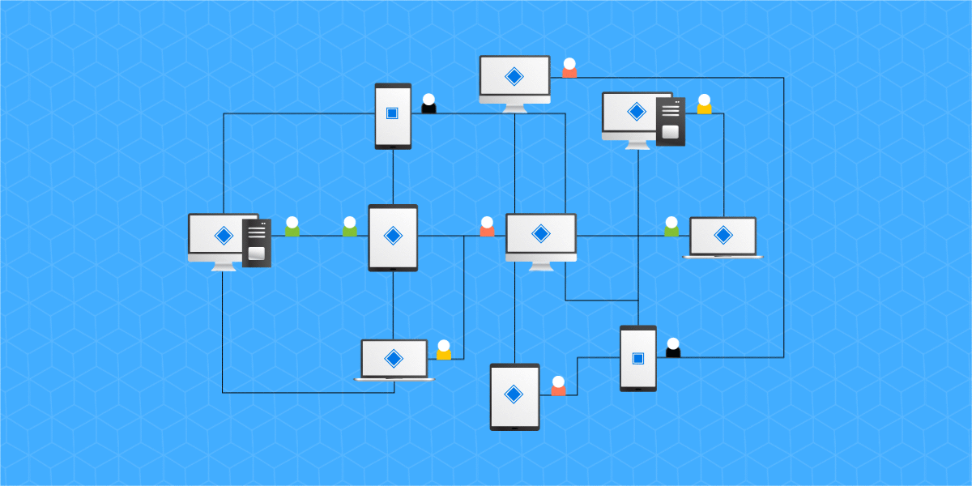
Resiliency
Traditional data storage and security systems are highly centralized, which means they have a single point of failure.
This implies that any external attack on the central server like malware or brute-force hacking attempts may lead to partial or total loss of stored data.
Depending on the type of data stored on the system, the consequences of data loss can be devastating for businesses and even economies.
Blockchain-powered storage is highly resilient to hacking and other forms of external attacks.

Slide 14
Resiliency
Since the same data is stored on all the nodes on a blockchain, there is minimal to no risk of data loss.
This means that blockchain-based data security and storage are highly suited for the storage of vital information, such as financial transactions and customer identities.

Slide 15

Challenges with blockchain
As the blockchain ecosystem evolves and different use cases emerge, organizations in all industry sectors will face a complex and potentially controversial array of issues, as well as new dependencies.
There are various challenges that comes with blockchain
Awareness and understanding
Organization
Culture
Cost and efficiency
Regulation and Governance
Security and Privacy

Slide 16

Awareness and understanding
The principal challenge associated with blockchain is a lack of awareness of the technology.
One really must educate themselves about these emerging technologies, or suffer the fate of being exploited by those who do

Slide 17

Organisation
The blockchain creates most value for organizations when they work together on areas of shared pain or shared opportunity.
The problem with many current approaches, though, is that they remain stove-piped: organizations are developing their own blockchains and applications to run on top of them.
This defeats the purpose of distributed ledgers.

Slide 18
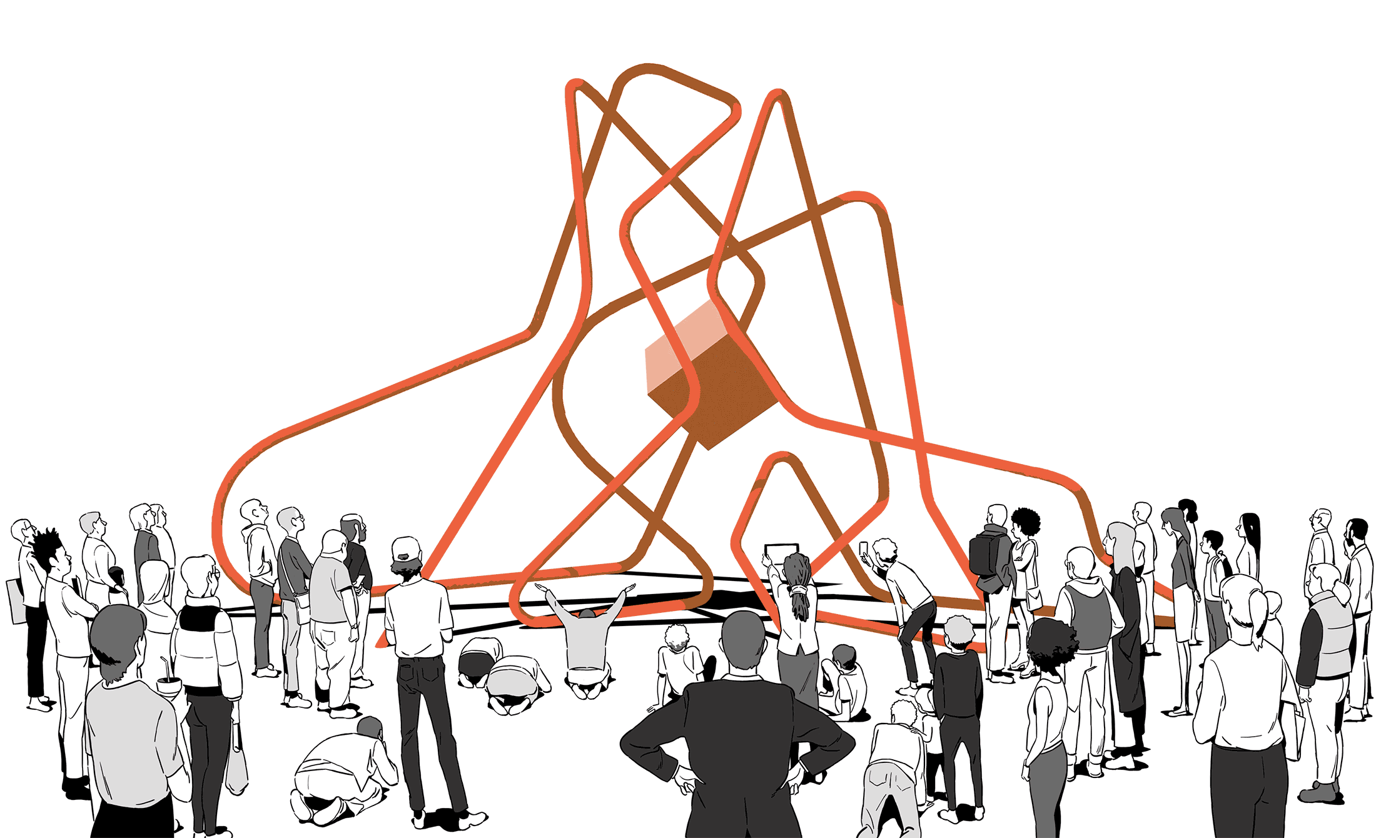
Culture
A blockchain represents a total shift away from the traditional ways of doing things – even for industries that have already seen significant transformation from digital technologies.
It has been estimated that a blockchain is about 80 per cent business process change and 20 per cent technology implementation.

Slide 19

Cost and efficiency
The speed and effectiveness with which blockchain networks can execute peer-to-peer transactions comes at a high aggregate cost, which is greater for some types of blockchain than others.
For the Bitcoin network, for example, which uses a proof-of-work approach in lieu of trusting participants in the network, the total running costs associated with validating and sharing transactions on the public ledger are estimated to be as much as $600 million a year and rising.

Slide 20

Regulation and Governance
Regulations have always struggled to keep up with advances in technology.
Centralized systems, particularly in financial services, also “act as shock absorbers in times of crisis” despite their challenges and bottlenecks. Decentralized networks can be much less resilient to shocks, which can impact participants directly, unless careful thought is given to their design.

Slide 21
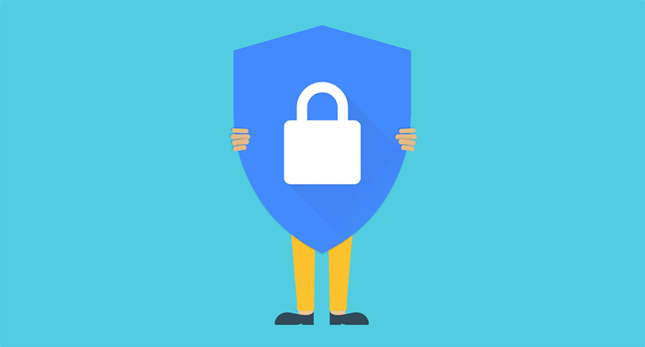
Security and privacy
Some argue that while no technology is completely secure, no one has yet managed to break the encryption and decentralized architecture of a Blockchain.
While cryptocurrencies like Bitcoin offer pseudonymity, many potential applications of the blockchain require smart transactions and contracts to be indisputably linked to known identities, and thus raise important questions about privacy and the security of the data stored and accessible on the shared ledger

Slide 22
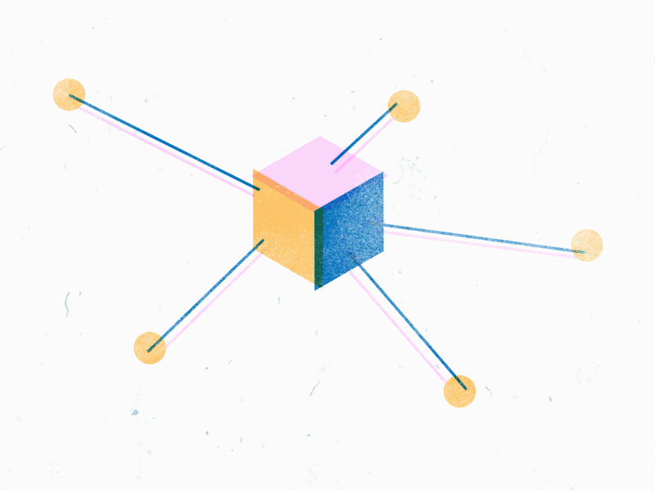
Centralization vs Decentralization
Decentralization is an important concept that is not unique to Bitcoin.
The notion of competing pattern of centralization versus decentralization arises in a variety of different digital technologies
In order to understand how it plays out in blockchain, it is useful to understand the central conflict between these two.

Slide 23
Centralization vs Decentralization
On the one hand we have the Internet, a famously decentralized system that has historically competed with and prevailed against “walled‐garden” alternatives like AOL’s and CompuServe’s information services.
Then there’s email, which at its core is a decentralized system based on the Simple Mail Transfer Protocol (SMTP), an open standard. While it does have competition from proprietary messaging systems like Facebook or LinkedIn mail, email has managed to remain the default for person‐to‐person communication online.

Slide 24
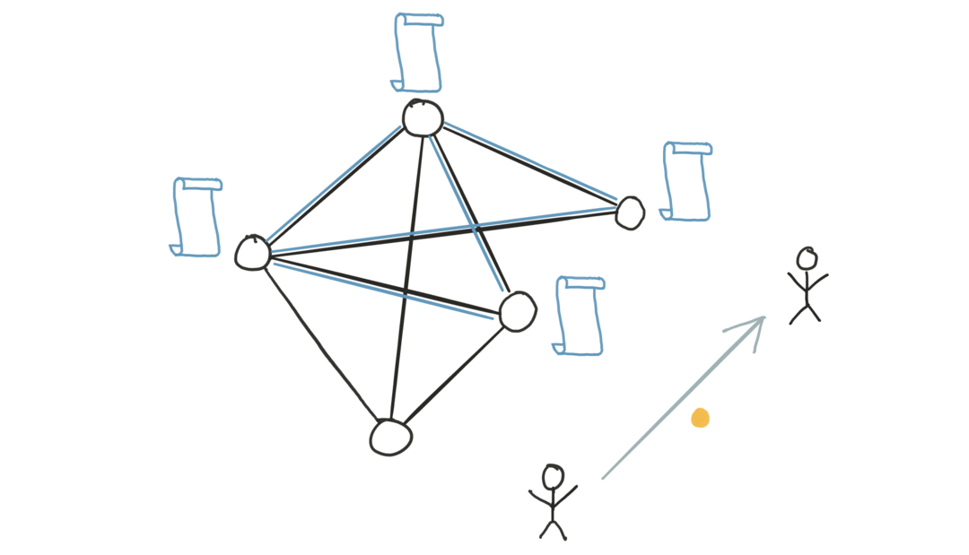
Centralization vs Decentralization
In the case of instant messaging and text messaging, we have a hybrid model that can’t be categorically described as centralized or decentralized.
Finally there’s social networking: despite numerous concerted efforts by hobbyists, developers and entrepreneurs to create alternatives to the dominant centralized model, centralized systems like Facebook and LinkedIn still dominate this space.
In fact, this conflict long predates the digital era and we see a similar struggle between the two models in the history of telephony, radio, television, and film.

Slide 25
Centralization vs Decentralization
Decentralization is not all or nothing; almost no system is purely decentralized or purely centralized.
For example, email is fundamentally a decentralized system based on a standardized protocol, SMTP, and anyone who wishes can operate an email server of their own.
Yet, what has happened in the market is that a small number of centralized webmail providers have become dominant.
Similarly, while the Bitcoin protocol is decentralized, services like Bitcoin exchanges, where you can convert Bitcoin into other currencies, and wallet software, or software that allows people to manage their bitcoins may be centralized or decentralized to varying degrees.

Slide 26
Centralization vs Decentralization
With this in mind, let’s break down the question of how the Bitcoin protocol achieves decentralization into five more specific questions:
1. Who maintains the ledger of transactions?
2. Who has authority over which transactions are valid?
3. Who creates new bitcoins?
4. Who determines how the rules of the system change?
5. How do bitcoins acquire exchange value?

Slide 27
Centralization vs Decentralization
Different aspects of Bitcoin fall on different points on the centralization/decentralization spectrum.
The peer‐to‐peer network is close to purely decentralized since anybody can run a Bitcoin node and There’s a fairly low barrier to entry.
You can go online and easily download a Bitcoin client and run a node on your laptop or your PC. Currently there are several thousand such nodes. Bitcoin mining is technically also open to anyone, but it requires a very high capital cost.

Slide 28
Centralization vs Decentralization
Because of this there has been a high degree of centralization, or a concentration of power, in the Bitcoin mining ecosystem. Many in the Bitcoin community see this as quite undesirable.
A third aspect is updates to the software that Bitcoin nodes run, and this has a bearing on how and when the rules of the system change.
One can imagine that there are numerous interoperable implementations of the protocol, as with email.
But in practice, most nodes run the reference implementation, and its developers are trusted by the community and have a lot of power

Slide 29
Distributed Consensus
Distributed consensus has various applications, and it has been studied for decades in computer science.
The traditional motivating application is reliability in distributed systems
It can be used to build a massive, distributed key-value store.
A distributed key-value store in turn would enable many applications.
For example, we could use it to build a distributive domain name system, which is simply a mapping between human understandable domain names to IP addresses. We could build a public key directory, which is a mapping between email addresses (or some other form of real‐world identity) to public keys.

Slide 30
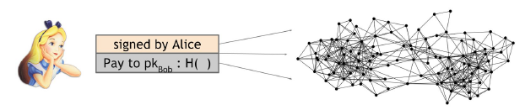
Distributed Consensus
A distributed consensus protocol has the following two properties:
It must terminate with all honest nodes in agreement on the value
The value must have been generated by an honest node
Cryptocurrencies are peer-to-peer system. When Alice wants to pay Bob, what she actually does is broadcast a transaction to all of the bitcoin nodes that comprise the peer-to-peer network.

Slide 31
Distributed Consensus
Incidentally, you may have noticed that Alice broadcasts the transaction to all the Bitcoin peer‐to‐peer nodes, but Bob’s computer is nowhere in this picture.
It’s of course possible that Bob is running one of the nodes in the peer‐to‐peer network.
In fact, if he wants to be notified that this transaction did in fact happen and that he got paid, running a node might be a good idea.
Nevertheless, there is no requirement that Bob be listening on the network; running a node is not necessary for Bob to receive the funds.
The bitcoins will be his whether or not he’s operating a node on the network.

Slide 32
Distributed Consensus
the nodes must agree on exactly which transactions were broadcast and the order in which these transactions happened.
This will result in a single, global ledger for the system.
So at any given point, all the nodes in the peer‐to‐peer network have a ledger consisting of a sequence of blocks, each containing a list of transactions, that they’ve reached consensus on.
Additionally, each node has a pool of outstanding transactions that it has heard about but have not yet been included on the block chain.
For these transactions, consensus has not yet happened, and so by definition, each node might have a slightly different version of the outstanding transaction pool
Notes:
In practice, this occurs because the peer‐to‐peer network is not perfect, so some nodes may have heard about a transaction that other nodes have not heard about.

Slide 33
Distributed Consensus
At regular intervals, say every 10 minutes, every node in the system proposes its own outstanding transaction pool to be the next block.
Then the nodes execute some consensus protocol, where each node’s input is its own proposed block.
Now, some nodes may be malicious and put invalid transactions into their blocks, but we might assume that other nodes will be honest.
If the consensus protocol succeeds, a valid block will be selected as the output. Even if the selected block was proposed by only one node, it’s a valid output as long as the block is valid.
Now there may be some valid outstanding transaction that did not get included in the block, but this is not a problem. If some transaction somehow didn’t make it into this particular block, it could just wait and get into the next block.

Slide 34
Public Blockchain
A public blockchain is permissionless. Anyone can join the network and read, write, or participate within the blockchain.
A public blockchain is decentralized and does not have a single entity which controls the network.
Data on a public blockchain are secure as it is not possible to modify or alter data once they have been validated on the blockchain.
Bitcoin and Ethereum are well-known examples of a public blockchain.

Slide 35
Private Blockchain
A private blockchain is a permissioned blockchain.
Private blockchains work based on access controls which restrict the people who can participate in the network.
There are one or more entities which control the network and this leads to reliance on third-parties to transact.
In a private blockchain, only the entities participating in a transaction will have knowledge about it, whereas the others will not be able to access it.
Hyperledger Fabric of Linux Foundation is a perfect example of a private blockchain.

Slide 36
Similarities of public and private blockchain
Both function as an append-only ledger where the records can be added but cannot be altered or deleted. Hence, these are called immutable records.
Each network node in both these blockchains has a complete replica of the ledger. Both are decentralized and distributed over a peer-to-peer network of computers.
In both, the validity of a record is verified, thus providing a considerable level of immutability, until the majority of the participants agree that it is a valid record and reach consensus. This helps prevent tampering with the records.
Both blockchains rely on numerous users to authenticate edits to the distributed ledger thus helping in the creation of a new master copy which can be accessed by everyone at all times

Slide 37
Differences between Public and Private blockchains
The order of magnitude of a public blockchain is lesser than that of a private blockchain as it is lighter and provides transactional throughput.
Level of access granted to participants- In a public blockchain, anyone can take part by verifying and adding data to the blockchain.
In private blockchains, only authorized entities can participate and control the network. Examples are Bitcoin and Ethereum.
A public blockchain is decentralized, whereas a private blockchain is more centralized. Examples- Hyperledger and Ripple.
Consensus algorithms such as Proof of Elapsed Time (PoET), Raft, and Istanbul BFT can be used only in case of private blockchains.

Slide 38
Differences Between Public and Private Blockchains
Transactions per second are lesser in a public blockchain when compared to private blockchains. As the number of authorized participants is less in a private blockchain, it can process hundreds or even thousands of transactions per second.
A public blockchain cannot compete with a private blockchain in terms of scalability issues as it is slow and hence can process transactions only at a slow pace. In a private blockchain, as only a few nodes need to manage data, transactions can be supported and processed at a much higher pace.

Slide 39
Differences Between Public and Private Blockchains
Public blockchains are trustless, and in a private blockchain setup, participants must not trust one another. In a private blockchain, the validity of records cannot be independently verified as the integrity of a private network relies on the credibility of the authorized nodes.

Slide 40
Differences between Public and Private blockchains
Access
In a private blockchain, only a single organization has authority over the network. So, it means that it’s not open for the public people to join in.
In reality, all the private blockchain solutions will have some form of authorization scheme to identity, who is entering the platform. Thus, only selected members have access to the network.
On the other hand, in a public blockchain network, anyone can join whenever they want. Basically, there are no restrictions when it comes to participation. More so, anyone can see the ledger and take part in the consensus process.

Slide 41
Differences between Public and Private blockchains
Authority
In a public blockchain, you’ll get true decentralization. This is something that is quite absent in private blockchain networks. As everyone has a copy of the ledger, it creates a distributed nature as well.
On the other hand, private blockchain does have a big authority looking over the system.
You might think, how is this decentralized then? Well, it’s not technically, anyway. A private blockchain isn’t fully decentralized like public blockchain platforms. It’s more of a partially decentralized situation.
This is where public and private blockchain seems to differ in a smaller way. Even though private blockchains may be partially decentralized, it still works best for the enterprise environment.

Slide 42
Differences between Public and Private blockchains
Transaction Speed
For private blockchain vs public blockchain comparison, we can take a look at their transaction speeds. In reality, until a certain point, both platforms can perform quite the same. But after that certain point, the transaction speed varies drastically.
Usually, in a public blockchain, anyone can request for a transaction. So, when there are too many requests on the network, the network relatively slows down with the transaction speed. It can take a lot of time to even process a transaction then.
But not in private blockchain platforms. Here, only a handful of nodes can participate in the transaction process. So, speed always remains the same.

Slide 43
Differences between Public and Private blockchains
Consensus
In a public blockchain, nodes have no restrictions in joining the consensus process. As a result, everyone is free to participate and get the benefits of the platform.
On the other hand, private blockchain decides from beforehand who can join the consensus and who can’t. As a result, many nodes won’t really participate in the process at all.

Slide 44
Differences between Public and Private blockchains
Transaction Cost
Public blockchain platforms tend to have a higher transaction cost compared to private blockchain platforms. In reality, the enormous number of nodes on the platforms allows down the performance. And as a result, it takes a lot of time to process the requests. Thus, prices rise drastically.
On the other hand, in private blockchain platforms, the transaction fees are extremely low. Unlike public blockchain platforms, the transaction fee does not increase based on the number of requests. So, no matter how many people request for a transaction, the fees will always stay low and accurate.

Slide 45
Differences between Public and Private blockchains
Data Handling
In a public blockchain, anyone can read and write on the ledger. But you can’t alter it once it gets on the ledger.
But in a private blockchain, only the single organization can read and write on the ledger. More so, only a handful of nodes can write on the ledger. In some cases, they can even delete a block as well.

Slide 46
Differences between Public and Private blockchains
Immutability
The public blockchain network is fully immutable. But what does that mean? Well, it means that once a block gets on the chain, there is no way to change it or delete it. So, it makes sure that no one can just alter a certain block can get benefits from others.
On the other hand, private blockchains are partially immutable. In certain cases, authorities can delete a certain block if they seem it fit.

Slide 47
Differences between Public and Private blockchains
Efficiency
This is the last point of the public vs private blockchain guide. In reality, public blockchain is less efficient compared to private blockchain platforms. How? Well, public blockchain platforms deal with scalability issues, and they slow down when there are too many nodes on the platform.
On the other hand, private blockchain only has a handful of nodes on the platform. So, they always remain efficient no matter what.

Slide 48
Differences between Public and Private blockchains
 | Public Blockchain | Private Blockchain
Access | Anyone | Single Organization
Authority | Decentralized | Partially Decentralized
Transaction Speed | Slow | Fast
Consensus | Permissionless | Permissioned
Transaction Cost | High | Low
Data handling | Read and Write Access for anyone | Read and Write access for a single organization
Immutability | Full | Partial
Efficiency | Low | High

Slide 49
Public blockchain best features
High Security
Public blockchain companies always design every single platform in a way that offers full security. In reality, every single day, enterprises and organizations deal with online hacks. It’s becoming a big hindrance as the time is going by.
Furthermore, it causes billions and billions of dollar losses every year.
But with all the security protocols of a public blockchain, they can easily stop all the hacking issues they face. More so, they can finally ensure true value or better data quality for any project.
The security protocols may vary based on the platform, but I can safely say that public blockchains are more or less robust.

Slide 50
Public blockchain best features
Open Environment
As you already know, the public blockchain is open for all, just like its name. So, no matter where you reside, you can log into these platforms. You would only need a good internet connection and a computer.
So, you will always enjoy all the benefits that come from blockchain technology. More so, you can use it to transact in a safe environment. Also, you can make money from mining as well. However, not all public platforms offer mining features.
We have covered this topic more thoroughly in our courses. Make sure to check all the courses out as well!
Let’s check out the next feature in this public blockchain vs private blockchain guide.

Slide 51
Public blockchain best features
Anonymous Nature
This is actually one of the best features of public blockchains that most of the users love. Basically, here every one is anonymous. Actually, you won’t use your real name, or real identity hear. Everything would stay hidden, and no one can track you based on that.
As it’s a public domain, this feature is mainly for the safety of one’s possessions. However, people did use it for illegal reasons as well. Many criminals tend to use bitcoin to pay for illegal activities on the dark web.
But don’t judge it base don it’s bad past. People can use any new technology for bad and good purposes. Thus, it shouldn’t reflect on public blockchain technology in any way.

Slide 52
Public blockchain best features
No Regulations
In reality, public blockchain doesn’t have any regulations that the nodes have to follow. So, there is no limit to how one can use this platform for their betterment. However, the main issue is that enterprises can’t work in a non-regulated environment.
Why? Well, it’s because, without regulations, it’s hard to follow all of the needs a project may need. Thus, I would recommend using public networks on consumer platforms. It means that you shouldn’t use it as an internal networking system and use it as an external one.
Let’s check out the next feature in this public blockchain vs private blockchain guide.

Slide 53
Why use public blockchain
Full Transparency
Well, nothing can compare to a fully transparent platform to anything else. Basically, the public blockchain companies tend to design the platforms so that it’s fully transparent to anyone on the ledger.
It means that you can see the ledger anytime you want. So, there is no scope for any corruption or any discrepancies. Anyhow, everyone has to maintain the ledger and participate in consensus.
This is something that you find in private blockchain platforms.

Slide 54
Why use public blockchain
True Decentralization
In a public blockchain, you’ll get true decentralization. This is something that is quite absent in private blockchain networks. As everyone has a copy of the ledger, it creates a distributed nature as well.
Basically, in this type of blockchain, there isn’t a centralized entity. Thus, the responsibility of maintaining the network is solely on the nodes. With help from a consensus algorithm, they are updating the ledger, and it promotes fairness as well.
Furthermore, both of these features make sure that there is always a decentralized environment in the system.
Anyhow, let’s check out the next one in this public blockchain vs private blockchain guide.

Slide 55
Why use public blockchain
Full User Empowerment
Typically, in any network user has to follow a lot of rules and regulations. In many cases, the rules might not even be a fair one. But not in public blockchain networks. Here, all of the users are empowered as there is no central authority to look over their every move.
Also, these platforms are open to the public, so no corporation can stop you from downloading the nodes and joining the consensus.
This is something that you won’t see in private blockchain platforms. More so, if you check private blockchain, you’ll see that the users can’t enjoy full freedom.

Slide 56
Why use public blockchain
Immutability
The public blockchain network is fully immutable. But what does that mean? Well, it means that once a block gets on the chain, there is no way to change it or delete it. So, it makes sure that no one can just alter a certain block can get benefits from others.
In reality, every single organization deals with alteration issues. Either that happens offline or online. The best part is that the hash functions work as a security protocol.
Therefore, when a person tries to change the blocks, he/she will create a different chain separating from the original chain. Thus, canceling out their changes.
Anyhow, let’s check out private blockchain next in this public blockchain vs private blockchain guide.

Slide 57
Private blockchain best features
Full Privacy
Unlike public blockchain platforms, private blockchain solutions tend to focus on privacy concerns. So, if you are looking for a technology that can offer the highest level of privacy for your enterprise, then this is perfect for it.
It may seem a bit over the edge, but that is the truth. Enterprises always deal with security ad privacy issues. More so, they also deal with such sensitive information on a daily basis. If even one of them gets leaked, it can mean a massive loss for the company.
That’s why it’s necessary for a company to use a network that can secure this information. And this is where private blockchains come into play.

Slide 58
Private blockchain best features
High Efficiency
Even though public blockchain came first, they tend to lack inefficiency. Why? Well, it’s because they introduce everyone to the network. As a result, when more people try to use the features, it takes up a lot of resources that the platforms can’t back up.
Thus, it slows down rapidly. On the other hand, private blockchain only allows a handful of people in the network. In many cases, they even have certain tasks to complete. So, there is no way they can take up extra resources and slow down the platform.
To do this, private blockchains use eco-friendly consensus protocols to reach an agreement.
Let’s check out the next feature in this private vs public blockchain comparison guide.

Slide 59
Private blockchain best features
Stability
Private blockchain solutions are stable, and you will get the peace of mind you want from it. Basically, in every blockchain platform, you have to pay a certain fee in order to complete a transaction. But, in public platforms, the fee can increase to a great extent due to the pressure of nodes requesting transactions.
When there are too many transaction requests, it takes time to complete them. More so, as time increases, the fee increases drastically. But not in private blockchain platforms. As only a handful of people can request for transactions, there isn’t any form of delays.

Slide 60
Private blockchain best features
Empowering Enterprises
Private blockchain solutions work to empower the enterprises as a whole rather than individual employees. In reality, companies do need great technology to back up their processes. More so, these solutions are mainly for internal systems of an enterprise.
As they’re highly capable of backing up the companies and offer security, it’s necessary that you start implementing your own blockchain solutions based on this.
We did cover a much broader spectrum in how blockchain is influencing enterprises in our courses. So, make sure to check all the courses out as well.

Slide 61
Why use private blockchain
Saves Money
In reality, private blockchain saves a lot of money. Maintaining a private blockchain is rather simple compared to public blockchains. Private blockchain platforms take up only a few resources. But on the other hand, public blockchain takes up a lot to support the enormous crowd on the platforms. Thus, in the long run, it saves a lot of money.
But it’s doesn’t mean that it’s hugely cheap or something.

Slide 62
Why use private blockchain
Low Fees
In private blockchain platforms, the transaction fees are extremely low. Unlike public blockchain platforms, the transaction fee does not increase based on the number of requests. So, no matter how many people request for a transaction, the fees will always stay low and accurate.

Slide 63
Why use private blockchain
Regulations
If you are looking for the perfect technology for your enterprise company, then private blockchain might be the right pick. Why? Well, in enterprises, you have to follow a lot of rules and regulations. And if you don’t follow them accordingly, there are certain consequences.
In a private blockchain, the theory is quite similar. In reality, it allows you to outline all the rules, and your employees have to follow it.

Slide 64
Why use private blockchain
No Illegal Activity
As you already know, private blockchain platforms have authentication processes before you can log into the network. What this process does is filter any intruders trying to get into the system.
I’ve already told you that public blockchain solutions have a bitter past with connection to criminal activities. Obviously, in an enterprise environment, it’s not something that you would want.
Thus, only verified individuals get an entry into the system, getting rid of all illegal activities.

